Slide 1
SIMULATION OF BINARY MULTIPLIER
INNOVATIVE PROJECT REPORT
2K19/CO/319
RITIK SINGH

Slide 2
Introduction
A binary multiplier is a combinational logic circuit or digital device used for multiplying two binary mubers used in digital electronics, such as a computer.
The two numbers are more specifically known as multiplicand and multiplier and the result is known as a product.
The multiplicand & multiplier can be of various bit size. The product’s bit size depends on the bit size of the multiplicand & multiplier. The bit size of the product is equal to the sum of the bit size of multiplier & multiplicand.
It is built using binary adders.
Most techniques involve computing a set of partial products, and then summing the partial products together.

Slide 3
Objective:
The project is about simulating a binary multiplier which are used for reducing partial products and computing faster results using adders.
The architecture of the multiplier is divided into three stages- a partial product generation stage, a partial product addition stage and final addition stage.

Slide 4
ADDERS
In electronics, an adder is a digital circuit that performs addition of two or more numbers.
Adders can be constructed for many numerical representations, such as Binary-coded decimal or excess-3 
Adders are different types in generally

Slide 5
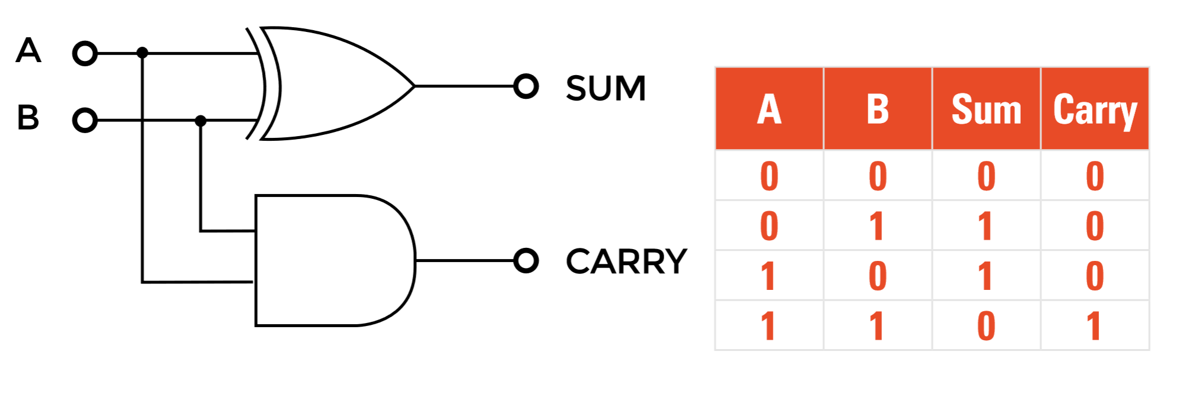
HALF ADDER
The half adder adds two single binary digits A and B. 
It has two outputs, sum (S) and carry (C).

Slide 6
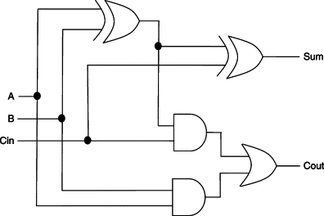
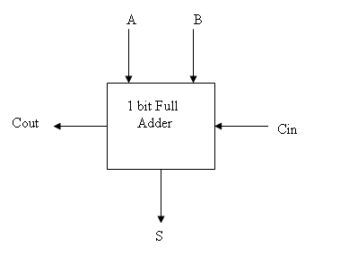
FULL ADDER 
A full adder adds three one-bit numbers, often written as A, B, and Cin. 
A and B are the operands, and Cin is a bit carried in from the previous less significant stage.

Slide 7
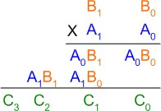
Adder Example
Example: Consider an example of multiplication of two numbers, say A and B (2 bits each), C
= A x B. ▪
The first partial product is formed by multiplying the B₁B₀ by A₀. The multiplication of two
bits such as A₀ and B₀ produces a 1 if both bits are 1; otherwise it produces a 0 like an
AND operation. So the partial products can be implemented with AND gates.
The second partial product is formed by multiplying the B₁B₀ by A₁ and is shifted one
position to the left.

Slide 8
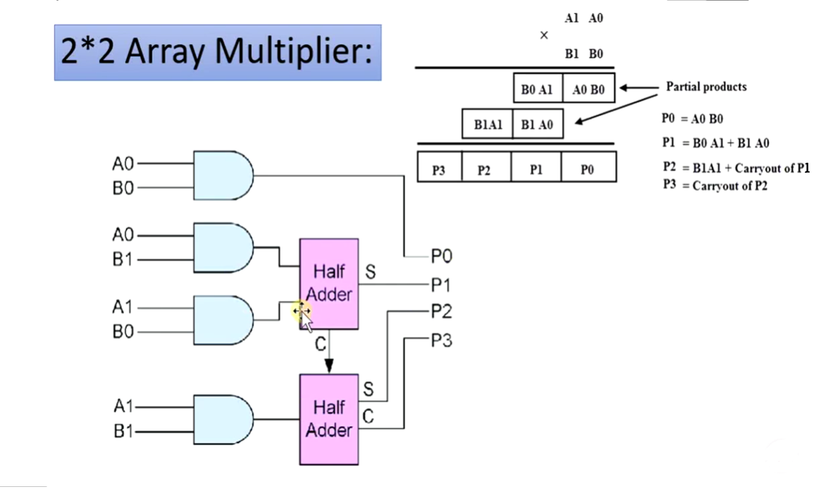
Adder Example

Slide 9
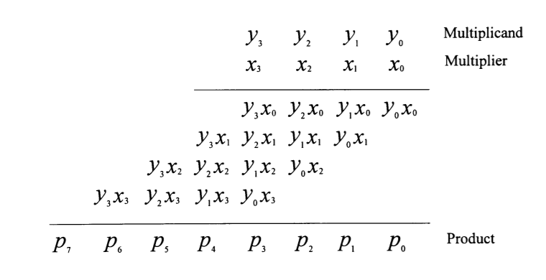
MULTIPLICATION
Multiplication process has three main steps:
Partial product generation
Partial product reduction
Final addition.
The common multiplication method is the “add and shift “algorithm.

Slide 10
Example:
Let us take an example of multiplying two binary numbers as follows. The process is similar to multiplying two decimal numbers, with a difference that the resulting numbers are all binary.
110 = 6
X 011 = 3
-------------------------
1 1 0 ; 110 X 1 (Shifted one position left)
1 1 0 x ; 110 X 1 (Shifted one position left)
0 0 0 x x ; 110 X 0 (Shifted one position left)
-------------------------
1 0 0 1 0 = 18

Slide 11
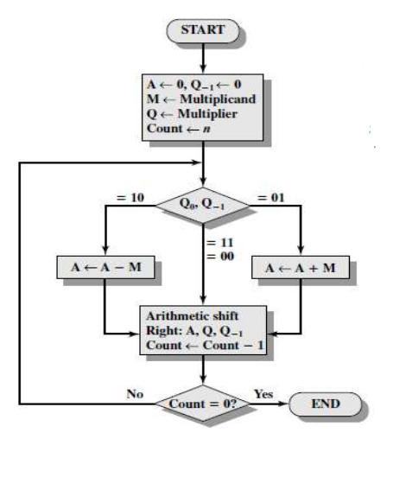
Booths Algorithm for Multiplication
A : It represents the Accumulator which stores the partial
product, It is initialized with Zero (0)
M: It represents the multiplicand
Q: It represents the multiplier,
Q₀: it represents the LSB of Q
Q₋₁ : It represents a Flip Flop which is initialized with Zero(0)
Count: It represents the counter(number of bits in M or Q)
Note: In Arithmetic Shift Right, We copy the sign bit of the
number in MSB

Slide 12
Working on the Booth Algorithm
Set the Multiplicand and Multiplier binary bits as M and Q, respectively.
Initially, we set the AC and Q_{n + 1} registers value to 0.
SC represents the number of Multiplier bits (Q), and it is a sequence counter that is continuously decremented till equal to the number of bits (n) or reached to 0.
A Q_{n} represents the last bit of the Q, and the Q_{n+1} shows the incremented bit of Q_{n} by 1.
On each cycle of the booth algorithm, Q_{n} and Q_{n + 1} bits will be checked on the following parameters as follows:
i. When two bits Q_{n} and Q_{n + 1} are 00 or 11, we simply perform the arithmetic shift right operation (ashr) to the partial product AC. And the bits of Q_{n} and Q_{n + 1} is incremented by 1 bit.
ii. If the bits of Q_{n} and Q_{n + 1} is shows to 01, the multiplicand bits (M) will be added to the AC (Accumulator register). After that, we perform the right shift operation to the AC and QR bits by 1.
iii. If the bits of Q_{n} and Q_{n + 1} is shows to 10, the multiplicand bits (M) will be subtracted from the AC (Accumulator register). After that, we perform the right shift operation to the AC and QR bits by 1.
The operation continuously works till we reached n - 1 bit in the booth algorithm.
Results of the Multiplication binary bits will be stored in the AC and QR registers.

Slide 13
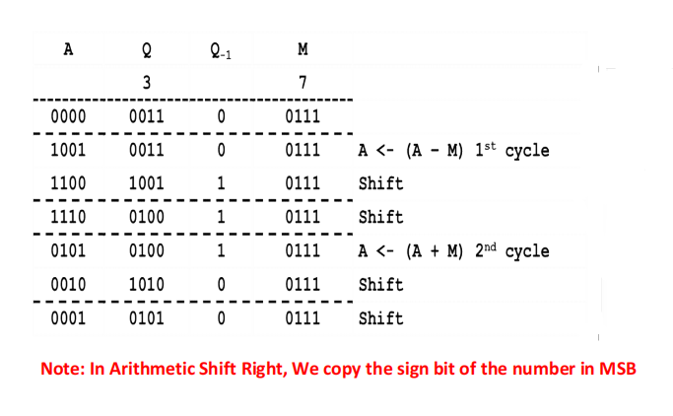
Example: Booths Algorithm for Signed Multiplication
Perform (7) x (3)
M 7: 0111
AC 3: 0011

Slide 14
Array Multiplier
An array multiplier is a digital combinational circuit used for multiplying two binary numbers by employing an array of full adders and half adders.
This array is used for the nearly simultaneous addition of the various product terms involved.
To form the various product terms, an array of AND gates is used before the Adder array.

Slide 15
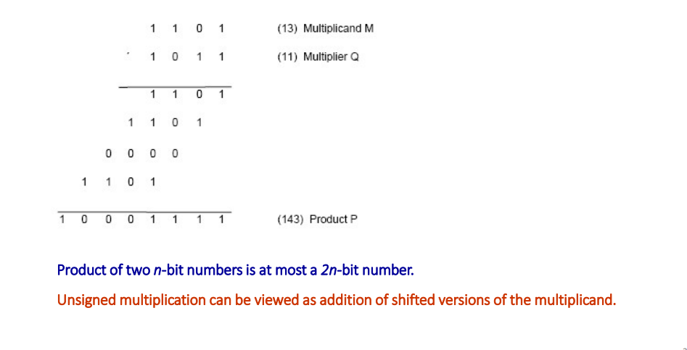
Array Multiplier

Slide 16
Advantages of Array Multiplier
The advantages of array multiplier are,
Minimum complexity
Easily scalable
Easily pipelined
Regular shape, easy to place and route

Slide 17
Disadvantages of Array Multiplier
The disadvantages of array multiplier are as follows,
High power consumption
More digital gates resulting in large areas.

Slide 18
APPLICATIONS OF MULTIPLIERS
These are most commonly used in various applications especially in the field of digital signal processing to perform the various algorithms.
Array multiplier is used to perform the arithmetic operation, like filtering, Fourier transform, image coding.
Commercial applications like computers, mobiles, high speed calculators and some general purpose processors require binary multipliers.
High-speed operation.

Slide 19
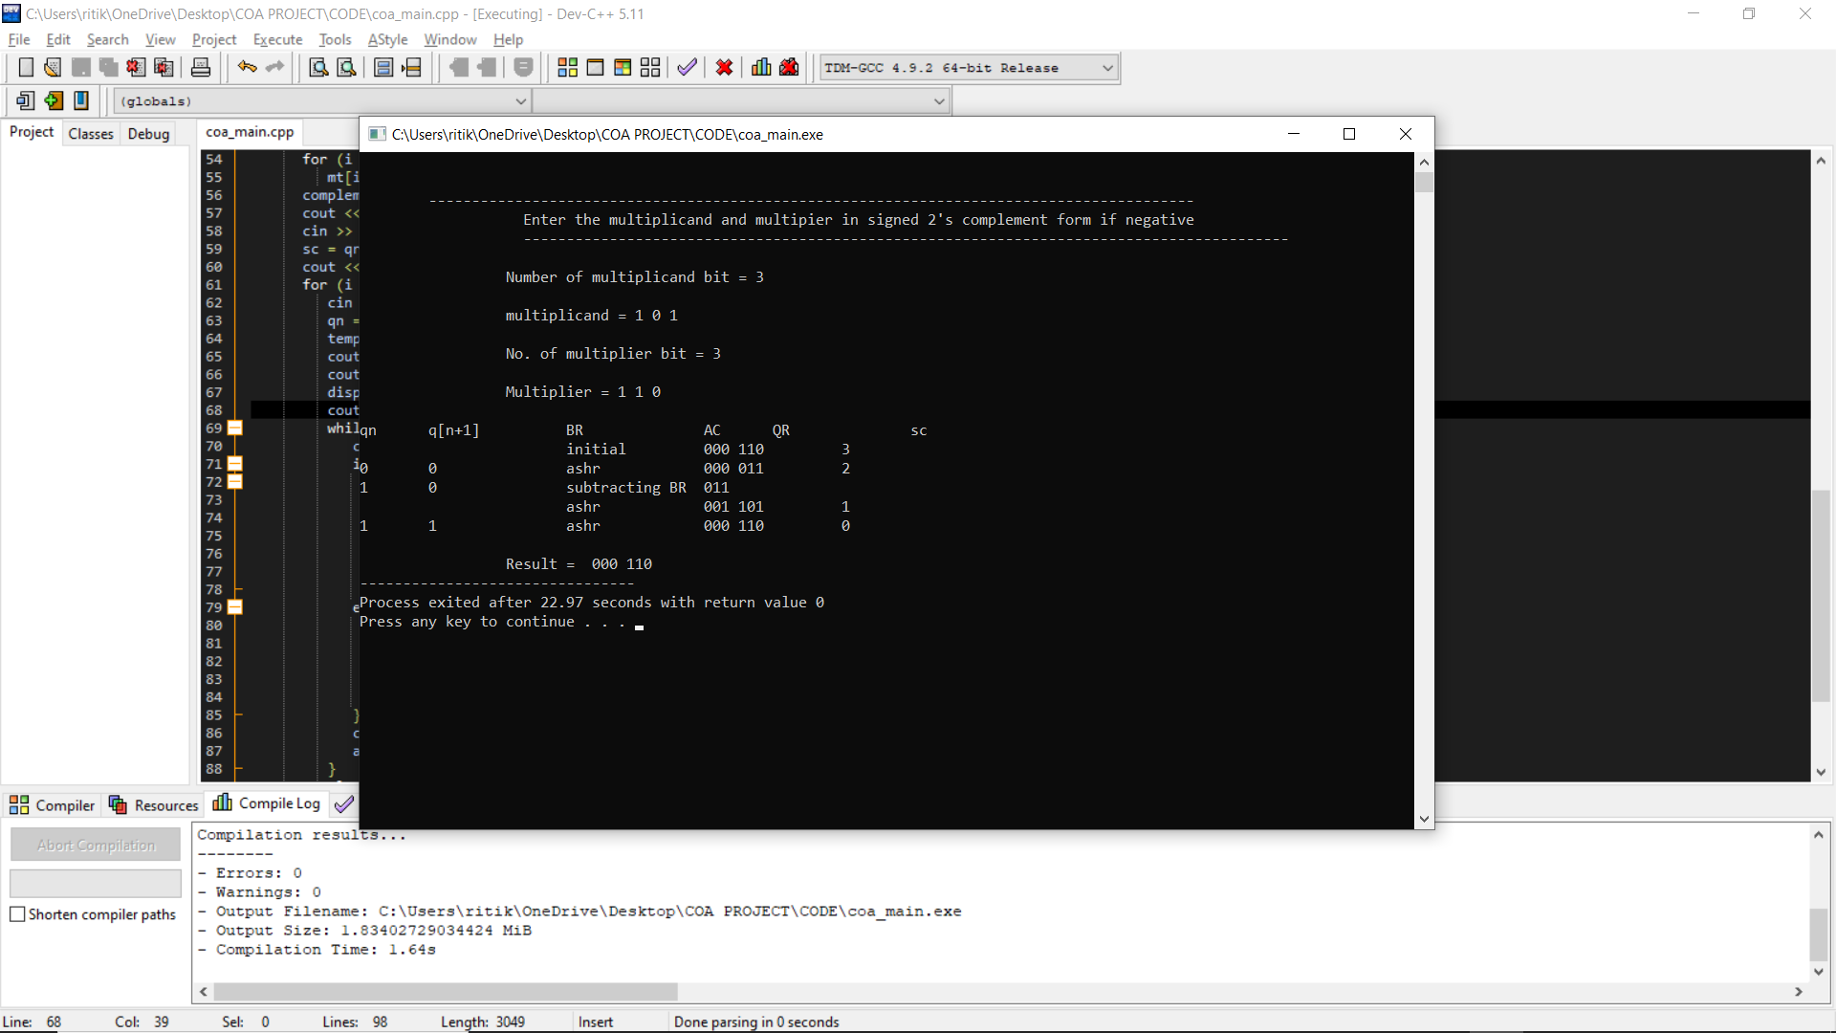
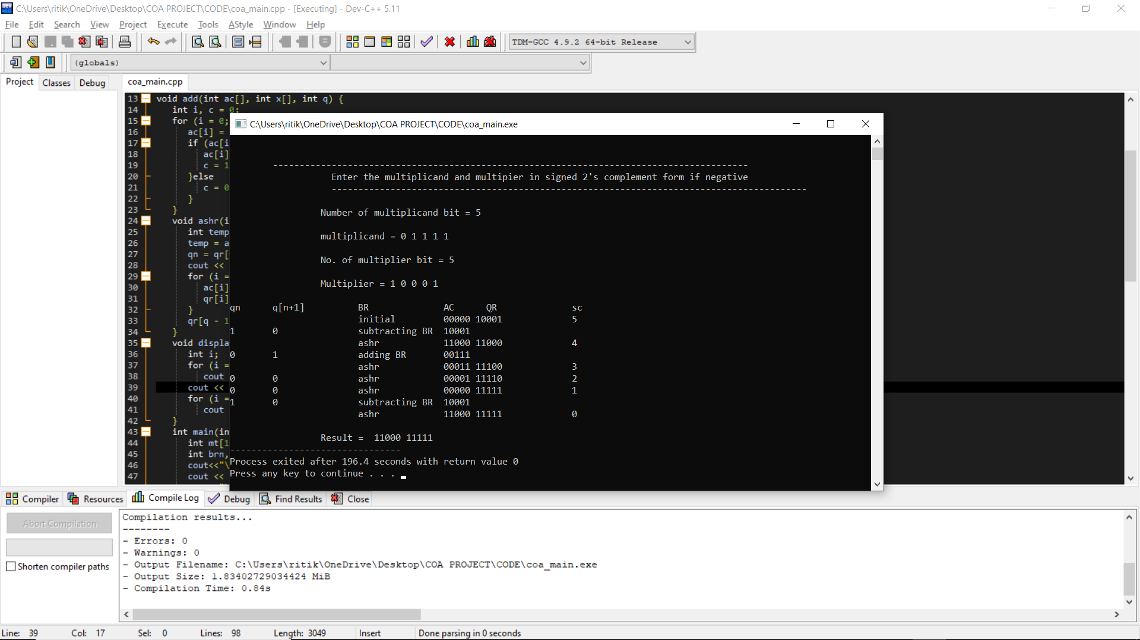
OUTPUT:
CODE IN THE WORD FILE.

Slide 20
Bibliography:
https://en.wikipedia.org/wiki/Binary_multiplier#:~:text=A%20binary%20multiplier%20is%20an,to%20implement%20a%20digital%20multiplier.
https://en.wikipedia.org/wiki/Multiplication_algorithm
https://vlsiuniverse.blogspot.com/2013/05/binary-multiplier.html#:~:text=Binary%20multiplication%20process%3A%20A%20Binary,provide%20the%20result%20as%20output.&text=The%20two%20numbers%20A1A0%20and,a%204%2Dbit%20output%20P3P2P1P0.
https://www.cs.columbia.edu/~martha/courses/3827/sp11/slides/2bit_multiplier_soln.pdf
https://www.electricaltechnology.org/2018/05/binary-multiplier-types-binary-multiplication-calculator.html
https://technobyte.org/multiplier-2-bit-3-bit-digital/
https://electronics.stackexchange.com/questions/99813/3-bit-multipliers-how-do-they-work/99837
https://inst.eecs.berkeley.edu/~eecs151/sp18/files/Lecture21.pdf
https://www.electronicshub.org/binary-multiplication/
https://www.sciencedirect.com/topics/engineering/binary-multiplication
https://en.wikipedia.org/wiki/Binary_multiplier

Slide 21
THANK YOU

